Slide 1
launch 一つで
navigation 開始！等
システムとして起動する時に欲しいもの等
cirkit_unit03_apps
(アプリケーション用 pkgs)
アプリケーション依存 pkgs
cirkit_unit03_hoge
が全部ここに来る
cirkit_unit03_pkgs
(CIR-KIT-Unit03 基本 pkgs)
アプリケーションに
依存せず必須なもの等
cirkit_unit03_deps
(CIR-KIT-Unit03 依存 pkgs)

Slide 2
current
waypoint1
waypoint2
current
waypoint1
waypoint2
switch to
the next one
close enough

Slide 3
current
waypoint1
waypoint2
human
detection!
waypoint1
waypoint2
switch to
the detected point
human
current

Slide 4
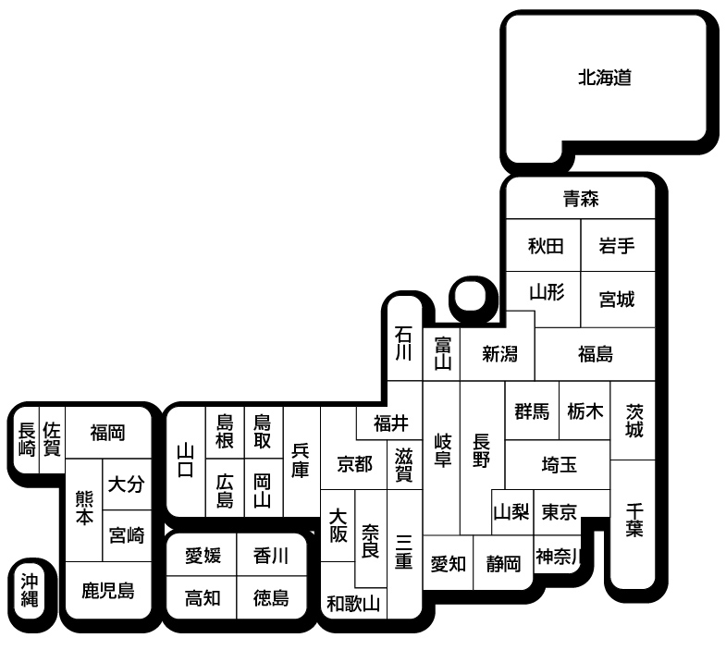
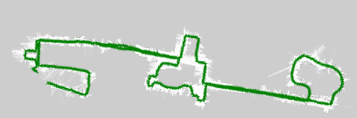
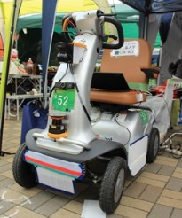
monitor_server
monitor_client
1200 km
away

Slide 5
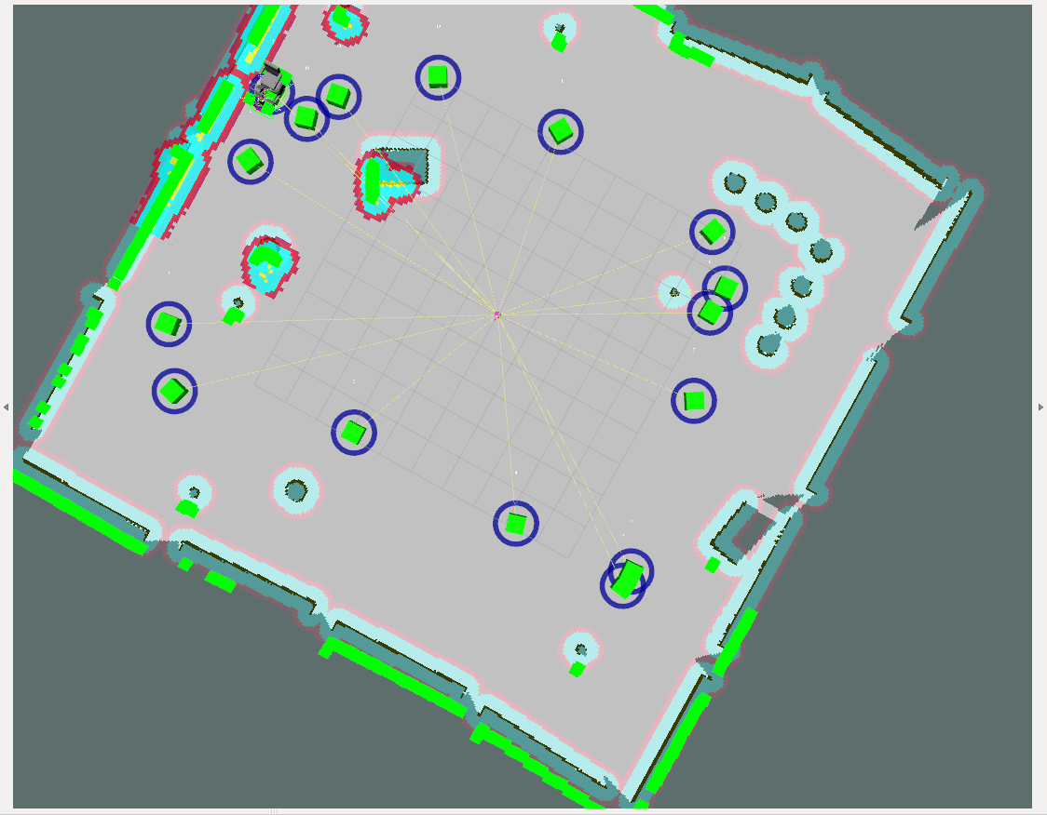
クリックして作成した
waypointの例．
ドラッグにより微調整可能

Slide 6
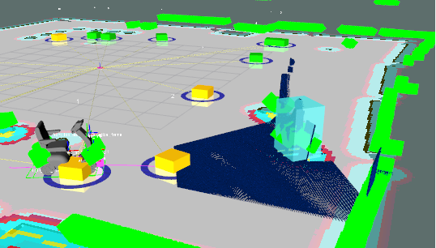
CIR-KIT-Unit03 Detailed Configuration
Gazebo
simulator
Simulation
steer
Reality
Input/Output
Hardware
Encoders
wheel
URDF
cirkit_unit03.
gazebo.xacro
wheel
steer
readSim()
writeSim()
iMCs01 Micro Controller
Arduino Uno
Virtual Joint Conversion
Ackerman link
read()
write()
hardware_interface::RobotHWSim
hardware_interface::RobotHW
Gazebo Plugin
gazebo_ros_control
NEW
NEW
SteerBotHardwareGazebo
CirkitUnit03HadwareInterface
Joint States
(radians)
Joint Velocities
(radians/sec)
Joint Positions
(radians)
Joint States
(radians)
Joint Velocities
(radians/sec)
Joint Positions
(radians)
Forward State
Transmissions
Joint Limits
Forward State
Transmissions
Joint Limits
Velocity
Transmissions
Postion
Transmissions
Velocity
Transmissions
Postion
Transmissions
Hardware Resource Interface Layer
JointStateInterface
Velocity
JointInterface
Position
JointInterface
Joint States
(radiands)
Joint Velocities
(radians/sec)
Joint Positions
(radians)
Controller Manager
NEW
Controller:
joint_state_publisher
Controller:
steer_drive_controller
Controller Layer
Application Layer
NEW
ROS Interface
/joint_states
ROS Interface
/cmd_vel
stepback_and_steerturn_recovery
NEW
robot_state_publisher
move_base
TF
amcl
ROS Interface
/amcl_pose
remote_montor
Sensors
TF
ROS Interface
/goal
ROS Interface
/scan_multi
ira_laser_tools
/base_scan
hokuyo_node
LRF
NEW
/base_scan2
hokuyo_node
LRF
Rviz
waypoint_navigator
/scan_multi _filtered
laser_filter
Navigation Layer
ROS Interface
/recognized_result
Human Detection Layer
NEW
NEW
target_object_recognizer
ROS Interface
/clustering_result
target_object_detector
/hokuyo_cloud2
hokuyo3d
LIDAR

Slide 7
①
global path
②
global path
Stuck!
obstacle
Step back
obstacle
Oops, can’t turn in any direction...
It’s much better for turning.
③
global path
④
global path
Scan costmap
obstacle
Avoid the obstacle
obstacle
it’s on left
Ok, let me turn right to avoid the nearest obstacle on the left!

Slide 8
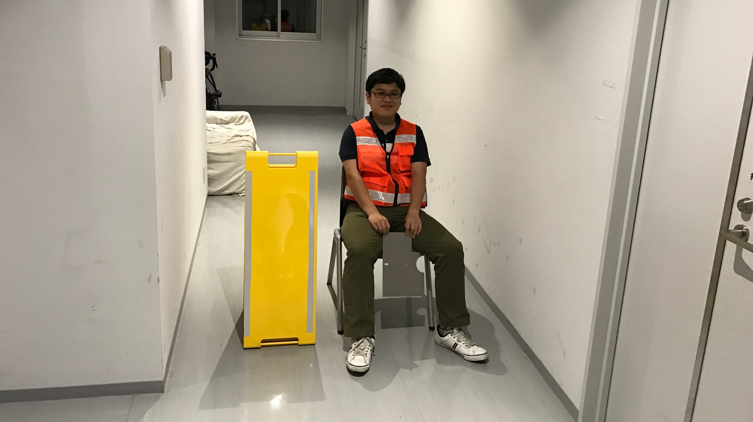


Slide 9

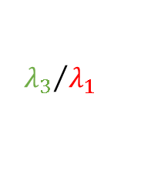

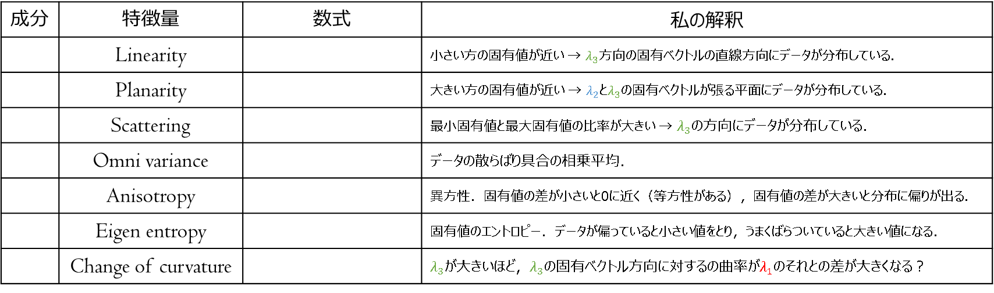

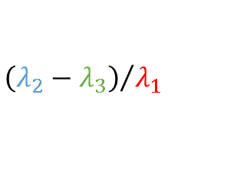
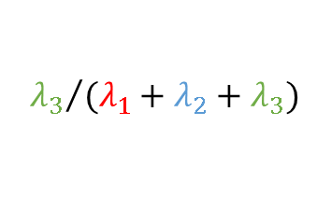
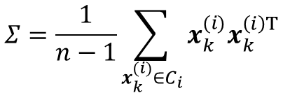
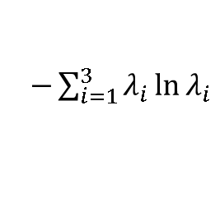

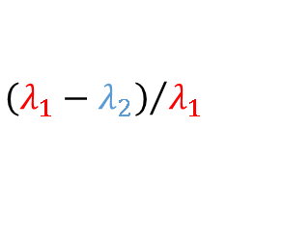

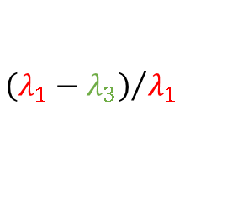




$$Σ=\frac{1}{n−1}\sum_{x_{k}^{(i)}∈C_{i}}{x_{k}^{(i)}x_{k}^{\left(i\right)T}}$$
$$λ_{1}<λ_{2}<λ_{3}$$
成分 | 特徴量 | 数式 | 私の解釈
 | Linearity |  | 小さい方の固有値が近い → $λ_{3}$方向の固有ベクトルの直線方向にデータが分布している．
 | Planarity |  | 大きい方の固有値が近い → $λ_{2}$と$λ_{3}$の固有ベクトルが張る平面にデータが分布している．
 | Scattering |  | 最小固有値と最大固有値の比率が大きい → $λ_{3}$の方向にデータが分布している．
 | Omni variance |  | データの散らばり具合の相乗平均．
 | Anisotropy |  | 異方性．固有値の差が小さいと0に近く（等方性がある），固有値の差が大きいと分布に偏りが出る．
 | Eigen entropy |  | 固有値のエントロピー．データが偏っていると小さい値をとり，うまくばらついていると大きい値になる．
 | Change of curvature |  | $λ_{3}$が大きいほど，$λ_{3}$の固有ベクトル方向に対するの曲率が$λ_{1}$のそれとの差が大きくなる？
$$f_{i21}$$
$${\left(λ_{1}−λ_{2}\right)}/{λ_{1}}$$
$$f_{i22}$$
$${\left(λ_{2}−λ_{3}\right)}/{λ_{1}}$$
$$f_{i23}$$
$${λ_{3}}/{λ_{1}}$$
$$f_{i24}$$
$$\sqrt[3]{λ_{1}λ_{2}λ_{3}}$$
$$f_{i25}$$
$${\left(λ_{1}−λ_{3}\right)}/{λ_{1}}$$
$$f_{i26}$$
$−\sum_{i=1}^{3}{λ_{i}\ln{λ_{i}}}$
$$f_{i27}$$
$${λ_{3}}/{(λ_{1}+λ_{2}+λ_{3})}$$

Slide 10
some navigator
some navigator
cmd_vel: v, w
w
cmd_vel: v, w
w
v
v
steer_drive_controller
θ
steer_drive_controller
θ
velocity_joint_interface: ω
velocity_joint_interface: ω
position_joint_interface: θ
ω
position_joint_interface: θ
ω
an instancd of RobotHW
steer_bot_hardware_sim
θ
θ
velocity_joint_interface: ω
velocity_joint_interface: ωl, ωr
position_joint_interface: θ
position_joint_interface: θ
Gazebo
Gazebo
ωl
ωr
ω

Slide 11
some navigator
cmd_vel: v, w
w
joints interfaces in steer_drive_controller
joints interfaces in
Gazebo
v
steer_drive_controller
θ
Interface to steer_drive_controller
Interface to Gazebo joint to virtually imitate closed link mechanism such as Ackerman link
Interface to Gazebo joint
to send velocity command
to each rear wheel
Interface to steer_drive_controller
velocity_joint_interface: ω
actual_front_steer_joint
actual_rear_wheel_joint
virtual_front_steers
virtual_rear_wheels
position_joint_interface: θ
ω
steer_bot_hardware_sim
θl
θr
velocity_joint_interface: ωl, ωr
position_joint_interface: θl, θr
virtual_front_wheels
Interface to Gazebo joint
to revieve current angle
of each front wheel
Gazebo
ωl
ωr

Slide 12
actual_rear_wheel_joint
ω
θ
actual_front_steer_joint
virtual_front_steers
virtual_rear_wheels
ωl
θr
θl
virtual_front_wheels

Slide 13
